Slide 1




DEPARTMENT OF COMPUTER SCIENCE AND ENGINEERING
Detection of Covert Data Exfiltration Channels through Network-Based Keylogger Traffic Analysis using Anomaly Detection Techniques
Batch - C5
Dr. K. Anand
Professor
Bhuvaanesh R (220701045)
Rethinaath S (220701222)

Slide 2
INTRODUCTION
Domain / Area of Project
The project falls under Network Security, focusing on covert data exfiltration and anomaly-based detection. It explores how keyloggers can misuse protocols like DNS and ICMP as covert channels to bypass traditional defenses, and proposes a detection mechanism using entropy and timing analysis within the field of cybersecurity and intrusion detection.
Importance of the Topic
With cyberattacks becoming more sophisticated, traditional security tools often fail to detect stealthy techniques like covert channels used for data theft. Understanding and detecting such hidden communication methods is crucial to protect sensitive information, strengthen network defenses, and stay ahead of advanced persistent threats in modern cybersecurity.

Slide 3
PROJECT OVERVIEW
Project Aim
The aim of this project is to design and implement a proof-of-concept network-based keylogger that exfiltrates data through covert channels like DNS and ICMP, and to develop an anomaly detection system that can identify such hidden malicious activity using entropy and timing analysis.
Overall Approach
The project simulates a network-based keylogger that captures keystrokes, encodes them using Base64/Base32 for DNS tunneling or maps them to specific inter-arrival time delays for ICMP exfiltration. On the detection side, network traffic is analyzed for anomalies by calculating Shannon Entropy for DNS queries and applying the Kolmogorov-Smirnov (KS) test for ICMP timing distributions, enabling the system to flag suspicious behavior that traditional antivirus tools often miss.

Slide 4
EXISTING SYSTEM
Current Systems
Antivirus Software – Detects known malware using signature-based scanning.
Intrusion Detection Systems (IDS) / Firewalls – Monitor traffic for suspicious patterns or rule violations.
Network Monitoring Tools – Capture and analyze packets for predefined threats.
Limitations
Signature Dependency – Fail to detect new or unknown malware variants.
Protocol Blindness – Struggle to identify misuse of legitimate protocols.
Focus on Payload – Often ignore timing-based or entropy-based covert channels.
Limited Adaptability – Cannot easily adapt to sophisticated attack methods without constant rule updates.

Slide 5
PROBLEM STATEMENT
Traditional antivirus and intrusion detection systems are effective against keyloggers that use standard data exfiltration methods such as HTTP or FTP, but they often fail when attackers employ covert-channels like DNS tunneling or ICMP timing.
These covert methods hide keystroke data within normal-looking network traffic, making it extremely difficult to distinguish malicious activity from legitimate communication.
As a result, sensitive information can be silently exfiltrated without raising alarms, highlighting the need for a detection system that goes beyond signature-based approaches and focuses on identifying anomalies in network behavior.

Slide 6
OBJECTIVES AND SCOPE
Key Objectives
Implement a Proof-of-Concept (PoC) keylogger that exfiltrates data via DNS and ICMP covert channels.
Encode keystrokes using Base64/timing channels and transmit them within normal-looking traffic.
Develop an anomaly detection system using entropy and timing analysis.
Generate alerts when suspicious covert exfiltration is identified.
Scope
Simulation of attack (keylogger) and defense (detector) in a virtual lab setup.
Focus on DNS tunneling and ICMP timing channels as covert communication methods.
Provide a foundation for extending anomaly detection to broader cybersecurity tools.

Slide 7
LITERATURE SURVEY
Author(s) / Year | Title of the Paper | Methodology / Approach | Inference
Wendzel et al. (2025) | DYST (Did You See That?): An Amplified Covert Channel That Points To Previously Seen Data | Taxonomy extension; DYST variants (Basic/Ext/Remote) with hash-based matching; PoC in Python/Scapy; evaluations using KS-test and compressibility on university/home traffic. | History channels achieve amplification (h bits/signal); low detectability (AUC~0.5); throughput 29-59 bits/min; enables stealth in constrained environments like IoT/malware C2.
Dhanushkodi & Thejas (2024) | AI Enabled Threat Detection: Leveraging Artificial Intelligence for Advanced Security and Cyber Threat Mitigation | Review of ML/DL techniques (CNN/RNN/GANs); simulations with CICFlowMeter/Metasploit; metrics like AUC-ROC/F1 on sectors (IoT/5G/Industry 5.0). | AI accuracies 92-98%; hybrids/GANs mitigate imbalance; challenges in real-time/privacy; ongoing collaboration needed for robust digital security.

Slide 8
LITERATURE SURVEY
Author(s) / Year | Title of the Paper | Methodology / Approach | Inference
Alketbi & Mehmood (2025) | A Comprehensive Survey of Explainable Artificial Intelligence Techniques for Malicious Insider Threat Detection | Systematic review categorizing XAI (SHAP/LIME) with ML/DL; datasets (DNSLog/CICIDS17); conceptual framework for ITD challenges. | XAI enhances transparency/trust; reduces false positives; gaps in imbalance/heterogeneity; future: privacy AI/human-loop benchmarks.
Vasilas & Brad (2025) | A Decade in Software-Based Side and Covert Channel Attacks and Countermeasures: A Survey | Citation-based review (>100 cites, 2016-2025); classification by components/mechanisms; comparative analysis (reliability/overhead). | Cache attacks dominant; defenses (constant time/noise) effective but overhead-heavy; trends: remote thermal; challenges in cloud/multicore.
Clinton & Hoque (2024) | MU-IoT: A New IoT Intrusion Dataset for Network and Application Layer Attacks Analysis | Testbed collection (30+ devices); 121 features/34.8M records/16 attacks; EDA/ML baselines. | Covers app protocols (AMQP/XMPP); aids centralized/federated IDMS; realistic for cybersecurity validation.

Slide 9
LITERATURE SURVEY
Author(s) / Year | Title of the Paper | Methodology / Approach | Inference
Rakine et al. (2025) | Comprehensive Review of Intrusion Detection Techniques: ML and DL in Different Networks | Literature classification by networks (CC/IoT/SDN); overview of techniques/datasets (NSL-KDD); strengths/limitations analysis. | DL excels in IoT anomalies; ML scalable in SDN; network context critical; proposes hybrid approaches for tailored IDS.
Zhen et al. (2025) | Anomaly Detection Model in Network Security Situational Awareness Based on Machine Learning: Limitation, Techniques, and Future Trends | Systematic review of ML/DL (autoencoder/GAN/LSTM); propose AFEMAD (multimodal fusion/FL/adaptive); challenge analysis. | Traditional insufficient vs. complex threats; AFEMAD addresses fusion/interpretability/privacy; guidance for scalable NSSA.
Tankovic et al. (2025) | A Survey on Data Plane Security in Software-Defined Networks: Toward Adaptive Security of Data Planes | Classify attacks (STRIDE/CIA/AAA); analyze solutions/experiments; propose adaptive mechanism combinations. | Data plane understudied; adaptive protects dynamics; performance constraints; future AI enhancements for SDN.

Slide 10
LITERATURE SURVEY
Author(s) / Year | Title of the Paper | Methodology / Approach | Inference
Ankalaki et al. (2025) | Cyber Attack Prediction: From Traditional Machine Learning to Generative Artificial Intelligence | Comparative ML/DL/XAI/GenAI/NLP; benchmarks (KDD99/CICIDS2017); trends in simulations/threat intel. | Proactive AI key; GenAI aids malware/password gen; data scarcity/adversarial issues; improves security posture via interpretability.
Alorainy (2025) | Echoes From the Void: Detecting DNS Tunneling With Blackhole Features in Encrypted Scenarios With High Accuracy | Blackhole simulation for behavioral features (retry/switch) + traditional metrics; random forest on GraphTunnel/CIC-Bell datasets. | 99.9% accuracy/F1; blackhole features dominant; lightweight for encrypted real-time; modular SIEM integration.
Filho et al. (2025) | Exploiting Temporal Variability in TCP Timestamps for Covert Channel Design | Two models embedding in TCP timestamp uncertainty; real-network experiments for indistinguishability/robustness. | Statistically blends with traffic; robust to loss/detection; enhances stealth/reliability over priors for secure covert transmission.

Slide 11
LITERATURE SURVEY
Author(s) / Year | Title of the Paper | Methodology / Approach | Inference
Ichise et al. (2025) | RPZ-Based Suspicious Direct Outbound DNS Traffic Detection Mechanism With Adaptive Policy Updates | RPZ registration of NS/glue records; mismatch flagging in SDN prototype; adaptive policy evaluation. | Accurate C&C detection/blocking; low overhead; deployable for pre-attack malware concealment.
Maz et al. (2024) | Majority Voting Ensemble Classifier for Detecting Keylogging Attack on Internet of Things | Ensemble (CNN/RNN/LSTM) with majority voting on BoT-IoT; compare to singles for accuracy/FPR. | High accuracy/low FPR; superior keylogging detection; improves IoT IDS with minimal disruption.
Razooqi & Pekar (2025) | VPN Traffic Analysis: A Survey on Detection and Application Identification | Systematic review (2016-2025); analyze features/methods/datasets for VPN/protocol/app tasks. | Encryption blinds DPI; DL trends effective; dataset limits; future new datasets for security/QoS.

Slide 12
LITERATURE SURVEY
Author(s) / Year | Title of the Paper | Methodology / Approach | Inference
Zhang et al. (2024) | Threat Detection Framework Based on Industrial Internet of Things Logs | Ontology/prompt extraction + temporal GNN anomaly + Sigma rule mapping; eval on DARPA datasets. | 94.38% recall/83.78% precision; contextual attack linking; aids IIoT analysts vs. quantitative gaps.
Ness (2025) | Securing Networks Against Adversarial Domain Name System Tunneling Attacks Using Hybrid Neural Networks | Hybrid LSTM/DNN for temporal/feature extraction; ablation on broad dataset for perturbations. | 85.2% accuracy > ML; LSTM/dropout critical; scalable for adversarial DNS in finance/health.
Kheddar et al. (2025) | Reinforcement-Learning-Based Intrusion Detection in Communication Networks: A Review | Categorize DRL/IDS/DRL-IDS; taxonomy (techniques/environments); comparative datasets/metrics. | DRL solves sequential IDS; unique triple focus; gains in IoT/ICS; future algos for secure nets.

Slide 13
METHODOLOGY
This approach integrates network forensics, covert channel analysis, and anomaly detection to identify hidden keylogging activity.
Focuses on detecting DNS-based and ICMP-based covert exfiltration used by the keylogger.
Implemented using VMWare Workstation with two Kali Linux VMs.
Victim VM: Runs the covert keylogger and performs DNS/ICMP covert data exfiltration.
Attacker/Detector VM: A dual-role machine. It acts as the Hacker’s Command & Control (C2) server receiving the stolen data, while simultaneously running the Unified NIDS (detector_integrated.py) to intercept and analyze the traffic as it crosses the network boundary.
This project mainly involves two modules – Attacker and Detection Module

Slide 14
METHODOLOGY – ATTACKER MODULE
Keylogging is implemented using Python’s evdev library, capturing raw EV_KEY events directly from the Linux kernel input subsystem (/dev/input/eventX) to bypass high-level GUI monitoring.
Keystrokes are aggregated into a local buffer to form efficient payloads, reducing the frequency of outbound packets and minimizing the network footprint.
A hybrid exfiltration strategy is built to exfiltrate the keystrokes efficiently
Smart Size Routing: The malware dynamically routes data based on payload size to maximize stealth.
< 5 Characters: Routed exclusively via ICMP Timing bursts.
≥ 5 Characters: Routed exclusively via DNS Hex/Base64 subdomains.
Covert exfiltration techniques include DNS and ICMP Covert Channels:
DNS covert channel: Encodes keystrokes inside DNS subdomains or query strings.
ICMP covert channel: Embeds keystrokes in ICMP payloads or manipulates timing intervals to signal data.

Slide 15
HYBRID EXFILTRATION - STRATEGY
Fixed-length buffers split typed words while per-keystroke transmission creates excessive and easily detectable network traffic.
A hybrid event-driven buffering strategy batches keystrokes intelligently based on natural typing behavior.
The module follows a Producer–Consumer queue architecture where the keylogger produces keystrokes and the exfiltration module consumes buffered data.
This design balances network stealth, readable captured data, and reliable transmission without losing keystrokes.

Slide 16
HYBRID EXFILTRATION – APPROACHES
The buffer flushes when SPACE or ENTER is detected, ensuring that transmitted data preserves complete human-readable words.
A 15-character hard limit prevents excessive buffering and ensures compatibility with DNS subdomain size constraints.
A 5-second idle timer automatically sends buffered keystrokes when the user pauses typing.
These triggers collectively ensure efficient batching, protocol safety, and prevention of lost keystrokes.

Slide 17
HYBRID EXFILTRATION – CONCURRENCY AND SHARED MEMORY - CHALLENGES
Running the typing process and idle-timer thread simultaneously introduces shared memory access to the same keystroke buffer.
Without control mechanisms, both threads may attempt to modify the buffer at the same moment.
This condition creates race conditions, potentially causing corrupted keystrokes or application instability.

Slide 18
HYBRID EXFILTRATION – RACE CONDITION
A race condition occurs when multiple threads attempt to read or modify the same shared memory simultaneously.
In the victim device, the typing thread adds captured keystrokes to the buffer while the timer thread periodically sends and clears the buffer.
If both threads access the buffer at the same moment, the memory state becomes inconsistent.
This collision can lead to lost keystrokes, corrupted data, or application instability during covert exfiltration.
The problem of Race Condition is addressed with Mutex lock.

Slide 19
HYBRID EXFILTRATION – MUTEX LOCK
A mutex lock (threading.Lock) is used to control exclusive access to the shared keystroke buffer.
The lock ensures that only one thread can read or modify the buffer at any given time.
This mechanism eliminates race conditions and guarantees thread-safe data handling during exfiltration.

Slide 20
MUTEX LOCK - EXAMPLE
Consider - one thread is copying and clearing the keystroke buffer for transmission, another thread may try to add a newly typed key at the same moment.
Without synchronization, both operations occur simultaneously and the buffer content may become corrupted or lose characters.
With a mutex lock, the first thread locks the buffer while performing the operation, forcing the second thread to wait briefly.
Once the lock is released, the second thread safely writes the new keystroke, ensuring the buffer remains consistent and no data is lost.

Slide 21
ATTACKER MODULE – SMART SIZE ROUTING
Small Payloads (< 5 characters): Routed exclusively via the ICMP Timing Channel. Binary data is translated into hardcoded time delays (e.g., 0.2s for ‘0’, 0.6s for ‘1’).
Large Payloads (≥ 5 characters): Routed exclusively via the DNS Storage Channel. Data is Hex/Base64 encoded and embedded into generated subdomains (e.g., 4b6579.test.google.com).

Slide 22
METHODOLOGY – DETECTION MODULE
Uses scapy for continuous packet capture and protocol-level inspection on Kali Linux.
DNS Anomaly Detector: Uses Shannon Entropy (H > 3.0) to catch Base64 payloads and Length-Bounded Regex to catch Hexadecimal exfiltration.
ICMP Anomaly Detector: Replaces the heavy KS-Test with a highly efficient Deterministic Binning Algorithm, mapping inter-packet delays directly to hardcoded malware signatures (0.2s and 0.6s bounds).
Implements adaptive baselining:
First records normal DNS and ICMP behavior.
Then raises alerts when live traffic deviates beyond defined thresholds.

Slide 23
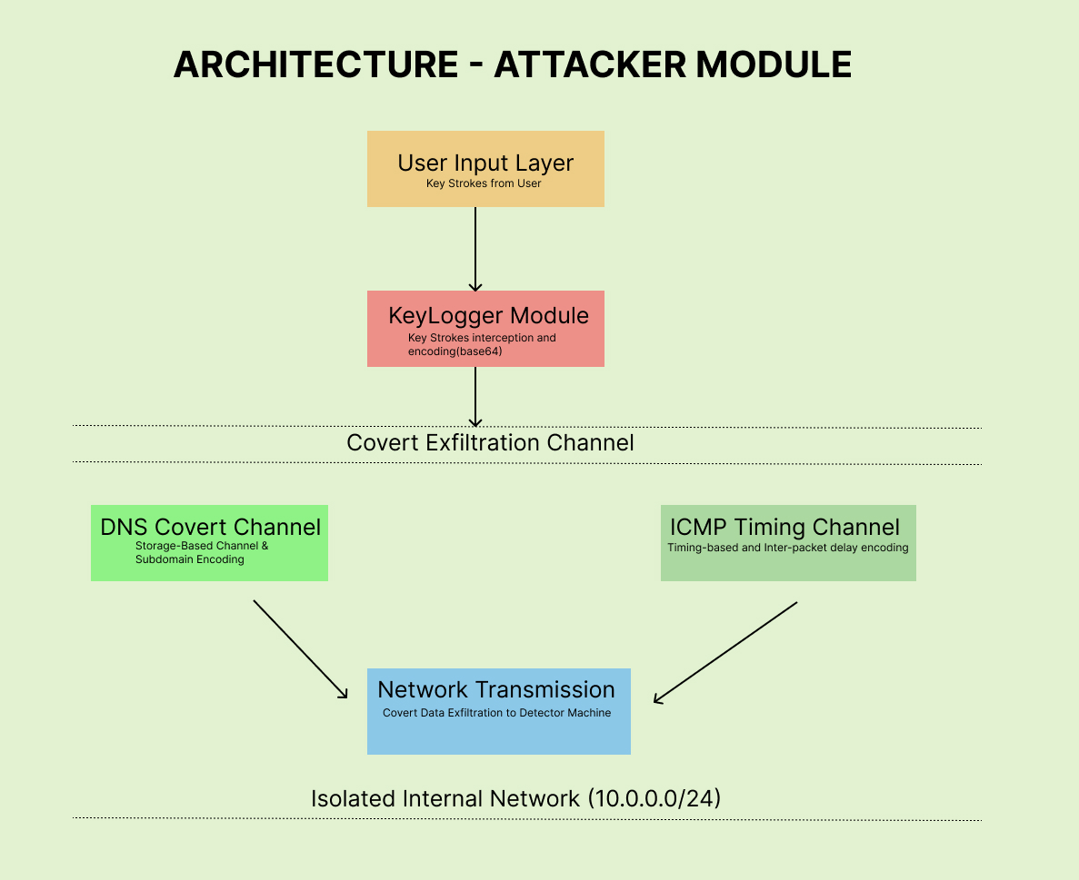
SYSTEM ARCHITECTURE - ATTACKER MODULE

Slide 24
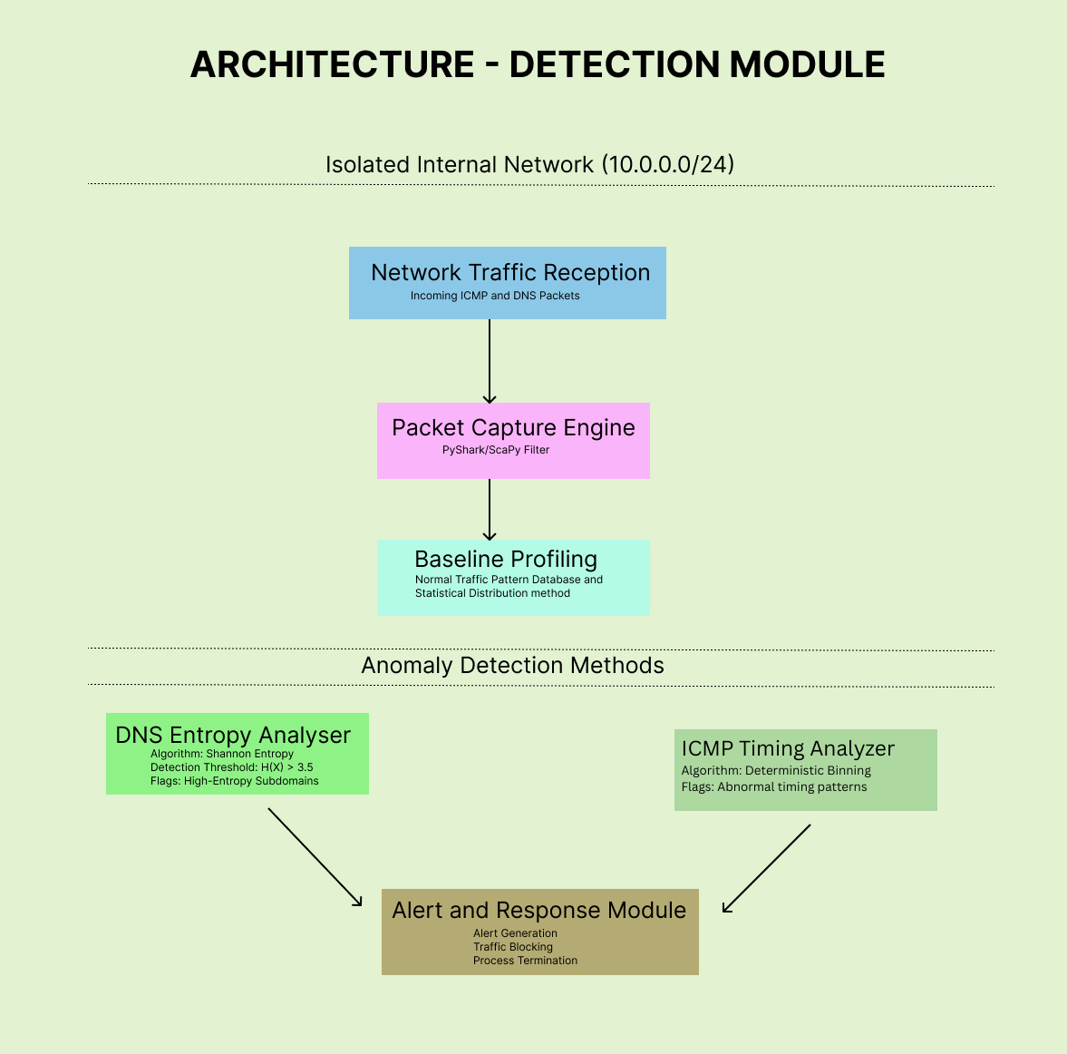
SYSTEM ARCHITECTURE – DETECTION MODULE

Slide 25
LIST OF MODULES
Keylogger & Buffer (VM-A): Batches keystrokes and routes via size (<5 ICMP, >=5 DNS).
Feature Extraction Engine (VM-B): Unified packet sniffer that strips headers and calculates metrics without making decisions.
DNS Receiver (VM-B): authoritative resolver + reconstructor.
ICMP Receiver (VM-B): timestamps → decode.
Cross-Protocol Correlator (VM-B): Aggregates dual-channel alerts.
DNS & ICMP Detectors (VM-B): Applies Entropy/Regex and Timing Binning algorithms.

Slide 26
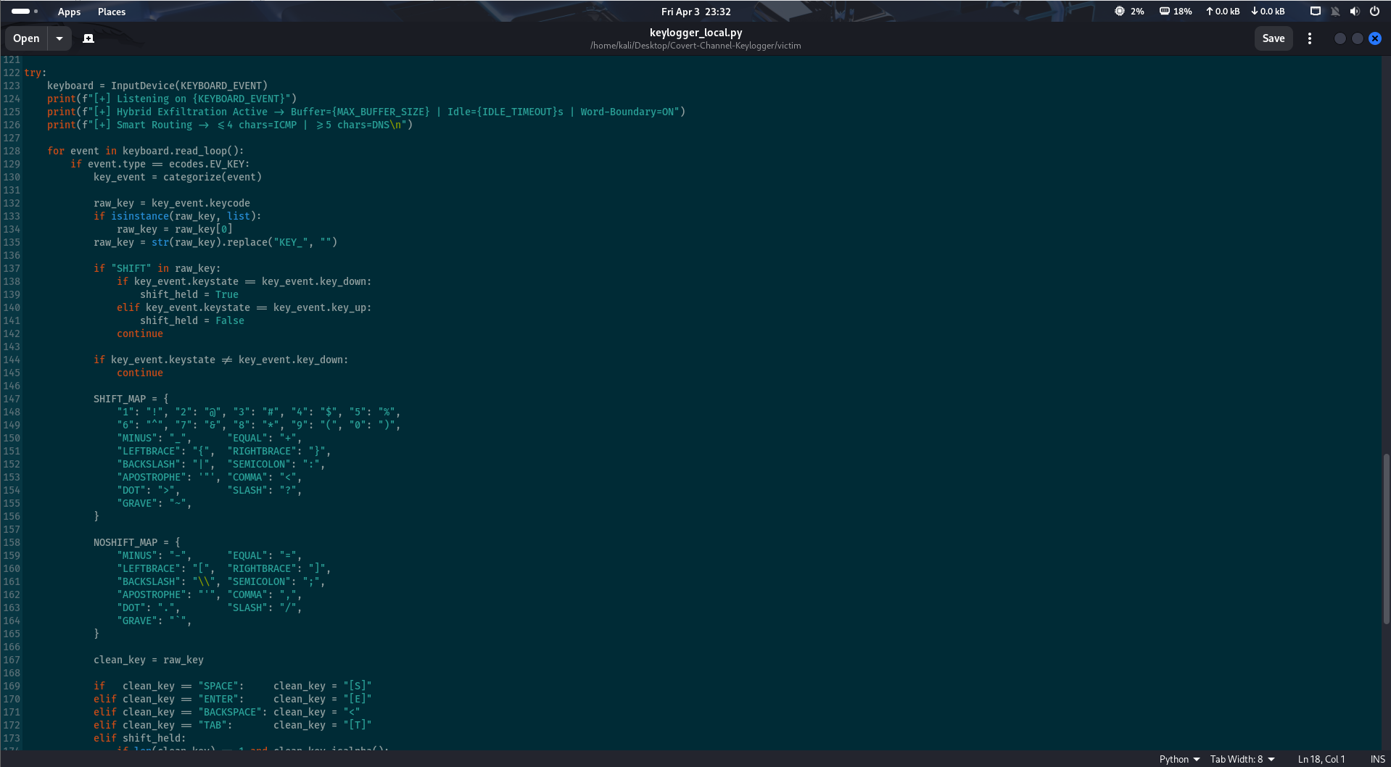
IMPLEMENTATION(Code) – keylogger_local.py

Slide 27
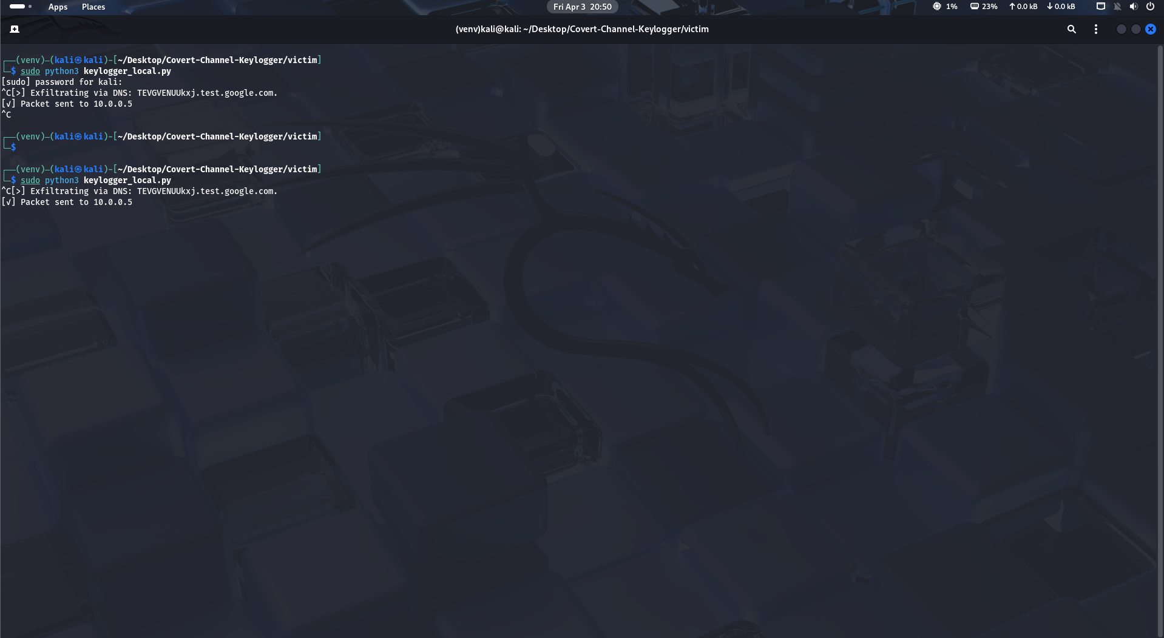
OUTPUT– keylogger_local.py

Slide 28
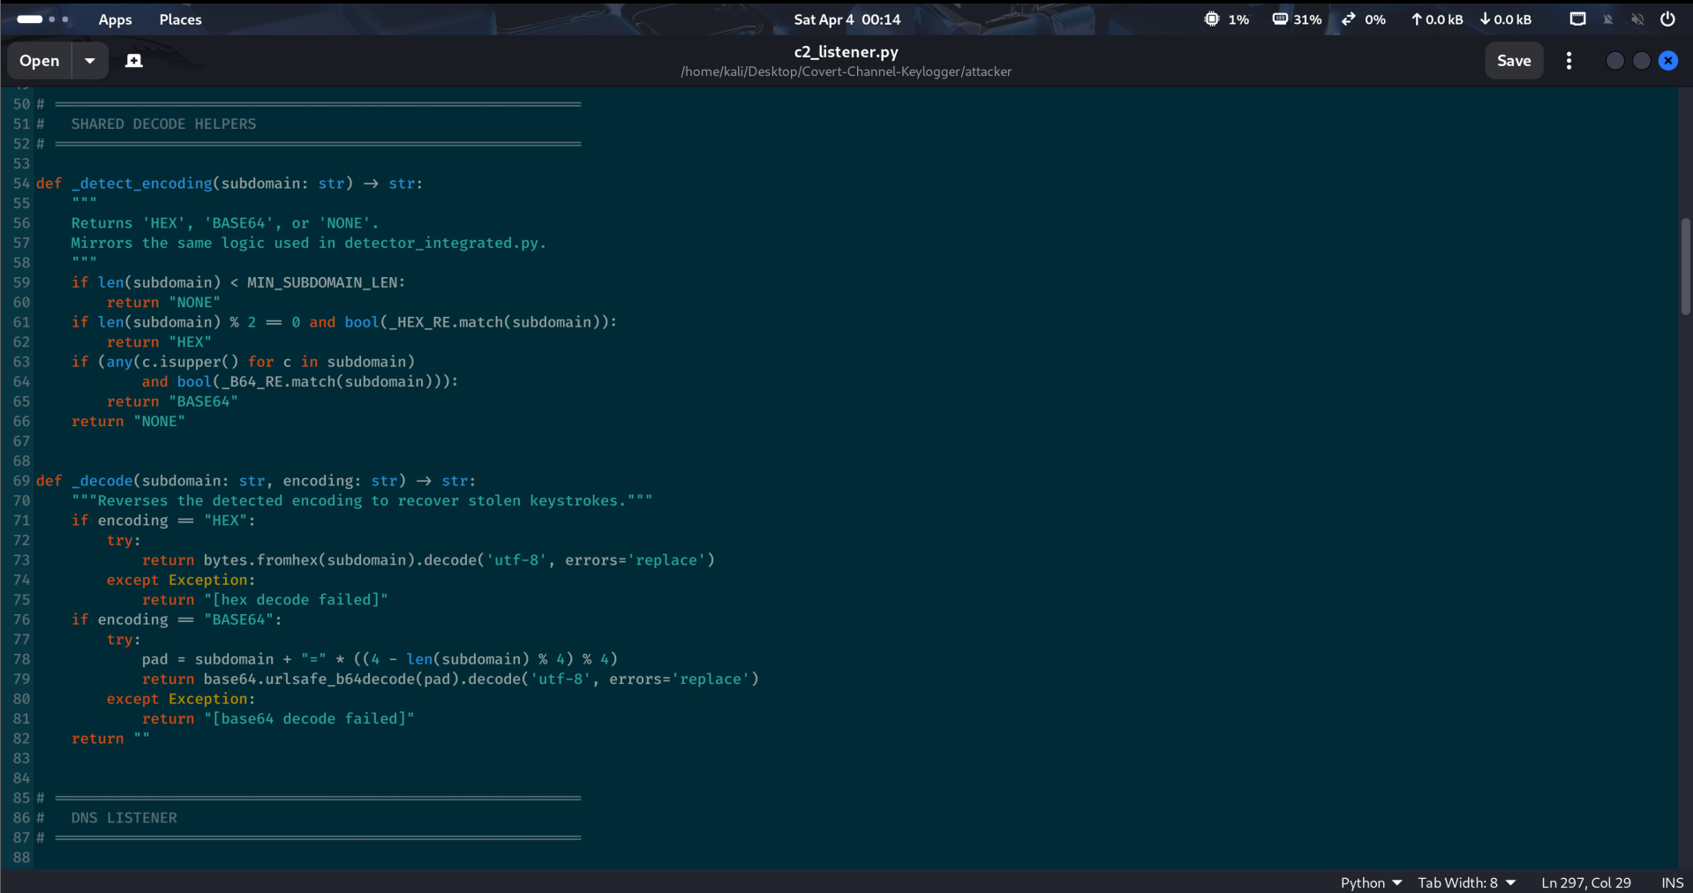
IMPLEMENTATION(Code) – c2_listener.py

Slide 29
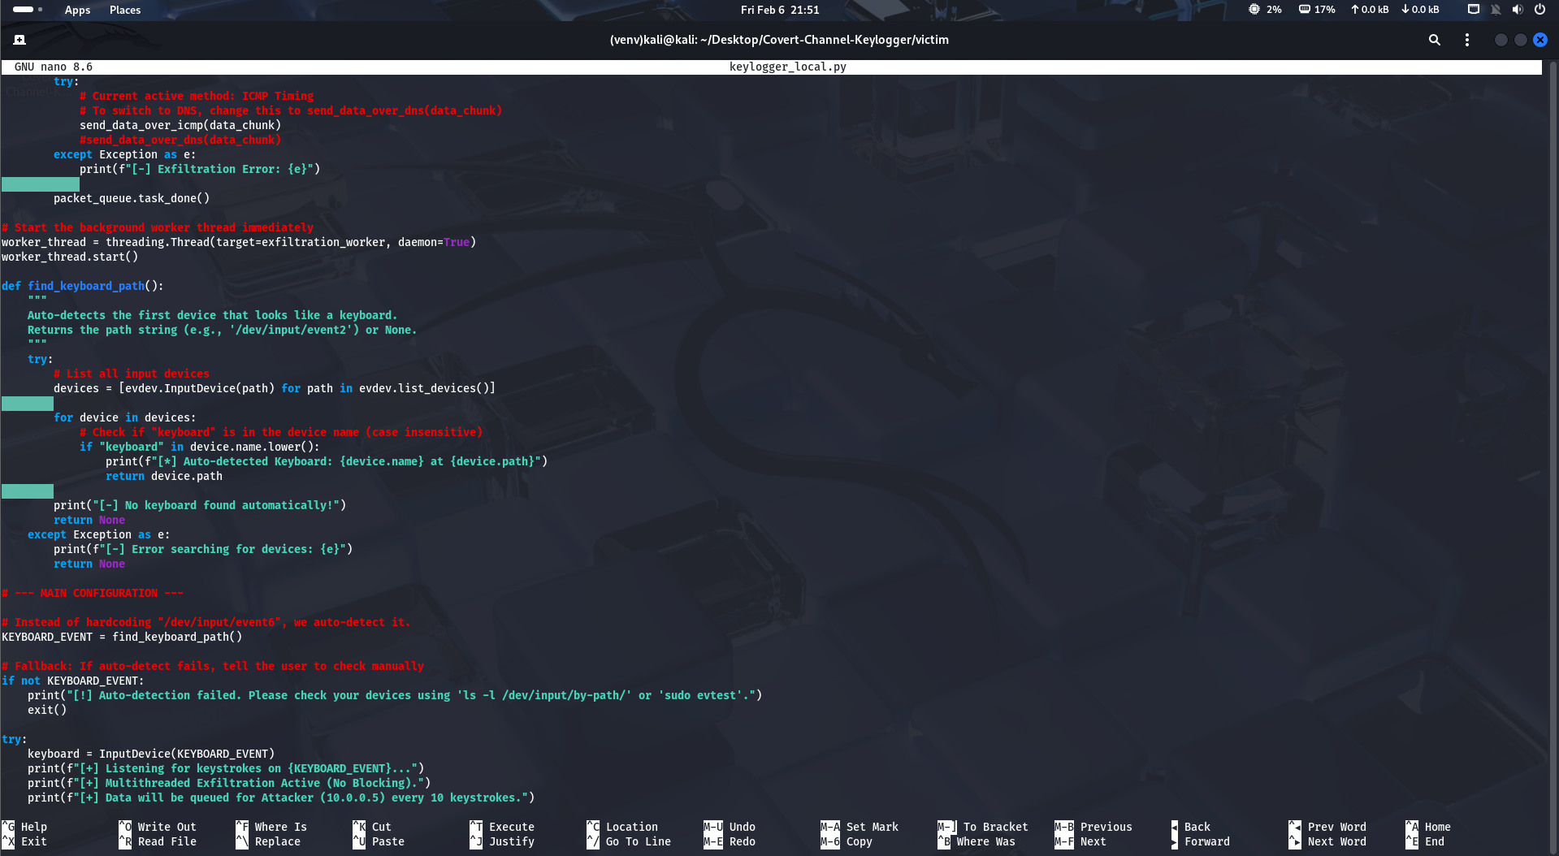
OUTPUT – c2_listener.py

Slide 30
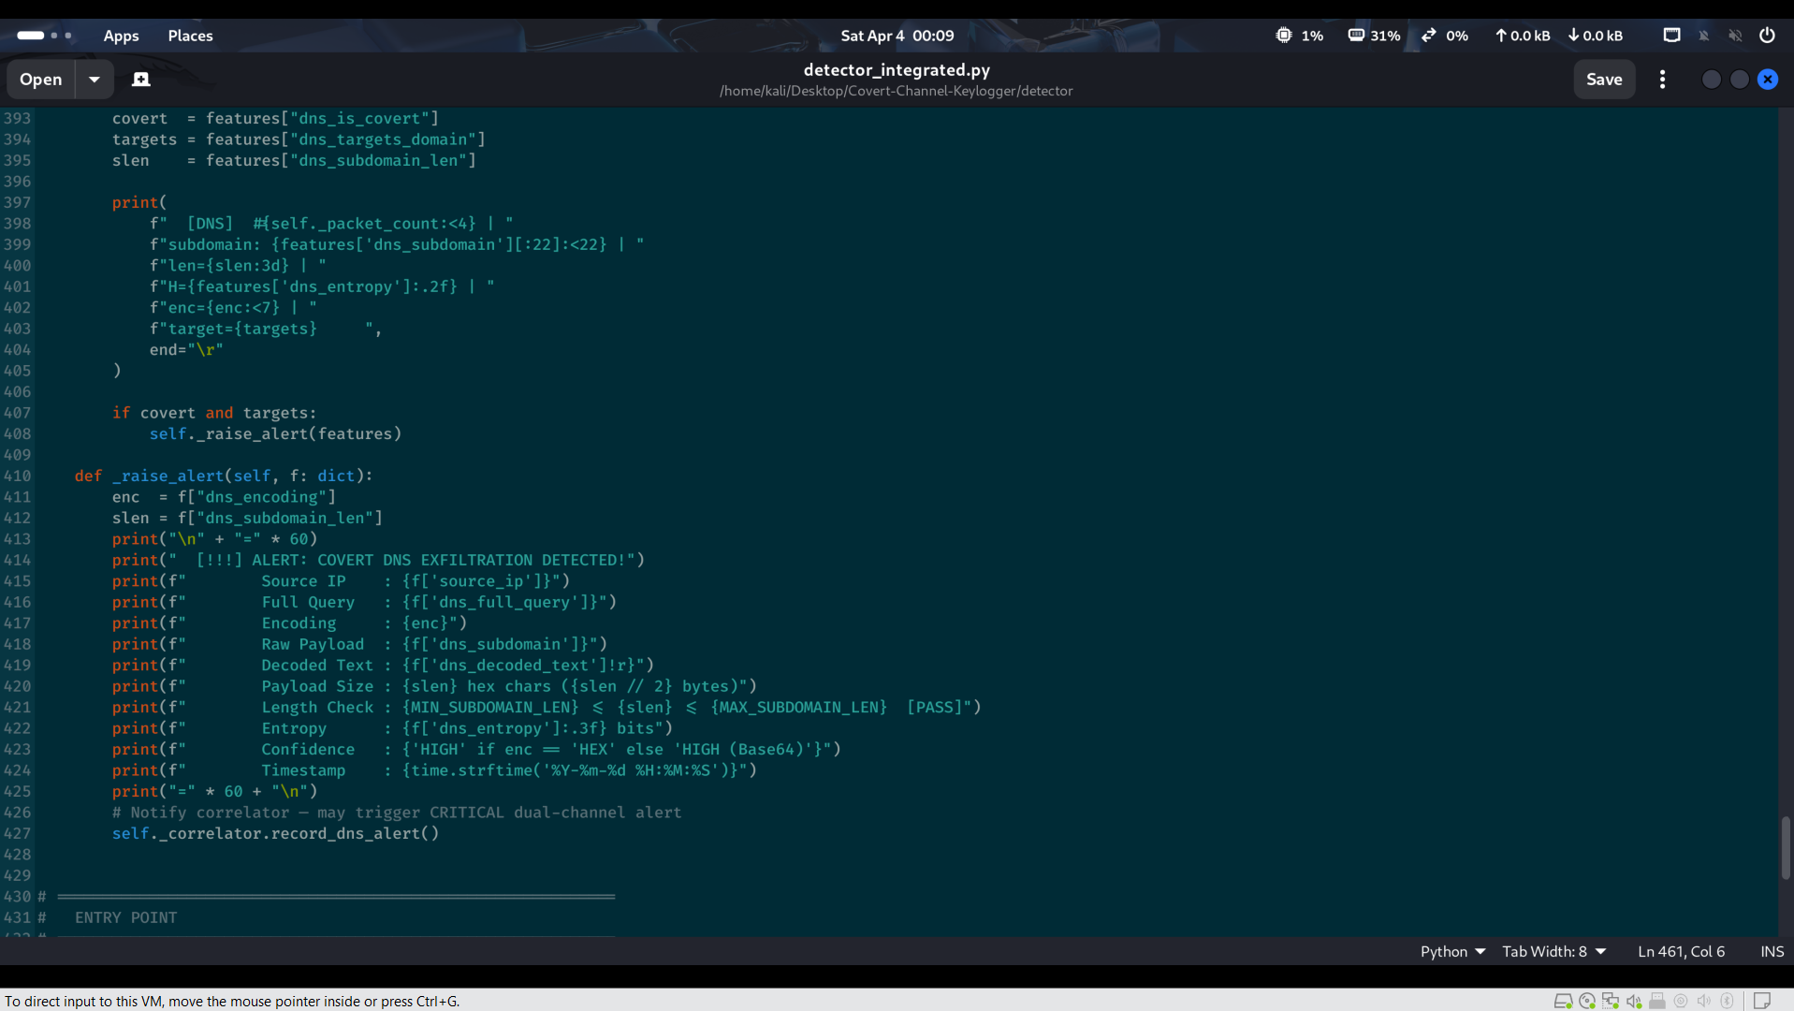
IMPLEMENTATION(Code) – detector_integrated.py

Slide 31
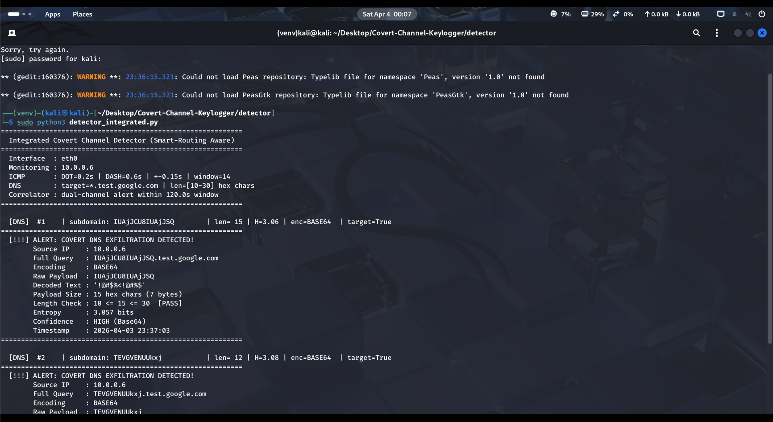
OUTPUT–detector_integrated.py

Slide 32
REFERENCE
[1] "DYST (Did You See That?): An Amplified Covert Channel That Points To Previously Seen Data," IEEE Access, vol. N/A, pp. N/A, Jan. 2025, doi: 10.1109/ACCESS.2025.10551462.
[2] "Echoes From the Void: Detecting DNS Tunneling With Blackhole Features in Encrypted Scenarios With High Accuracy," IEEE Access, vol. N/A, pp. N/A, Aug. 2025, doi: 10.1109/ACCESS.2025.11107436.
[3] "Comprehensive Review of Intrusion Detection Techniques: ML and DL in Different Networks," IEEE Access, vol. N/A, pp. N/A, Jun. 2025, doi: 10.1109/ACCESS.2025.11036755.
[4] "A Comprehensive Survey of Explainable Artificial Intelligence (XAI) in Network Intrusion Detection," IEEE Access, vol. N/A, pp. N/A, Jul. 2025, doi: 10.1109/ACCESS.2025.11075748.
[5] "VPN Traffic Analysis: A Survey on Detection and Application Identification," IEEE Access, vol. N/A, pp. N/A, Jul. 2025, doi: 10.1109/ACCESS.2025.11091298.
[6] "Threat Detection Framework Based on Industrial Internet of Things Logs," IEEE Access, vol. N/A, pp. N/A, Dec. 2024, doi: 10.1109/ACCESS.2024.10786974.

Slide 33
REFERENCE
[7] "Anomaly Detection Model in Network Security Situational Awareness Based on Machine Learning: Limitation, Techniques, and Future Trends," IEEE Access, vol. N/A, pp. N/A, Jul. 2025, doi: 10.1109/ACCESS.2025.11082123.
[8] "Securing Networks Against Adversarial Domain Name System Tunneling Attacks Using Hybrid Neural Networks," IEEE Access, vol. N/A, pp. N/A, Mar. 2025, doi: 10.1109/ACCESS.2025.10924244.
[9] "RPZ-Based Suspicious Direct Outbound DNS Traffic Detection Mechanism With Adaptive Policy Updates," IEEE Access, vol. N/A, pp. N/A, Feb. 2025, doi: 10.1109/ACCESS.2025.10887223.
[10] "Exploiting Temporal Variability in TCP Timestamps for Covert Channel Design," IEEE Access, vol. N/A, pp. N/A, Jul. 2025, doi: 10.1109/ACCESS.2025.11062641.
[11] "Reinforcement-Learning-Based Intrusion Detection in Communication Networks: A Review," IEEE Access, vol. N/A, pp. N/A, Aug. 2025, doi: 10.1109/ACCESS.2025.10729241.
[12] "UAV-NIDD: A Dynamic Dataset for Cybersecurity and Intrusion Detection in UAV Networks," IEEE Access, vol. N/A, pp. N/A, Jun. 2025, doi: 10.1109/ACCESS.2025.10937270.

Slide 34
REFERENCE
[13] "A Survey on Data Plane Security in Software-Defined Networks: Toward Adaptive Security of Data Planes," IEEE Access, vol. N/A, pp. N/A, Jun. 2025, doi: 10.1109/ACCESS.2025.11020661.
[14] "AI Enabled Threat Detection: Leveraging Artificial Intelligence for Advanced Security and Cyber Threat Mitigation," IEEE Access, vol. N/A, pp. N/A, Nov. 2024, doi: 10.1109/ACCESS.2024.10747338.
[15] "Cyber Attack Prediction: From Traditional Machine Learning to Generative Artificial Intelligence," IEEE Access, vol. N/A, pp. N/A, 2025, doi: 10.1109/ACCESS.2025.10909100.
[16] "MU-IoT: A New IoT Intrusion Dataset for Network and Application Layer Attacks Analysis," IEEE Access, vol. N/A, pp. N/A, Nov. 2024, doi: 10.1109/ACCESS.2024.10747334.
[17] "Majority Voting Ensemble Classifier for Detecting Keylogging Attack in IoT," IEEE Access, vol. N/A, pp. N/A, Feb. 2024, doi: 10.1109/ACCESS.2024.10419360.
[18] "A Dual-Strategy Framework for Cyber Threat Detection in Imbalanced, High-Dimensional Data Across Heterogeneous Networks," IEEE Access, vol. N/A, pp. N/A, Jul. 2025, doi: 10.1109/ACCESS.2025.11048903.

Slide 35
Thank You

